Slide 1
Programming Fundamentals
Week 1 – 2
Miya

Slide 2
Your new U:PASS Leader - Miya
3rd years of Bachelor of Information Technology.
Majoring in Cybersecurity, Networking and Enterprise Software Development.

Slide 3
Week 1 Introduction - Vocabulary
Algorithm :
Compile :
Debugging :

Slide 4
Week 1 Introduction - Vocabulary
Algorithm : A step-by-step set of instructions or rules to be followed to solve a specific problem or perform a task.
Compile : The process of translating the source code written by a human (Java) into machine code that a computer can understand and execute.
Debugging : The process of identifying, tracing, and fixing errors (bugs) in a computer program to ensure it runs correctly.

Slide 5
Types of Errors
Compile Error :
Runtime Error :
Logical Error :

Slide 6
Types of Errors
Compile Error : Rules of the language are broken. The code won't even start.
Runtime Error : The program starts but crashes while running.
Logical Error : The program runs without crashing, but the result is not what you expected.

Slide 7
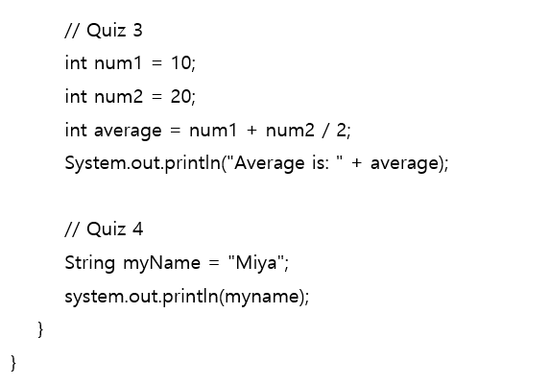
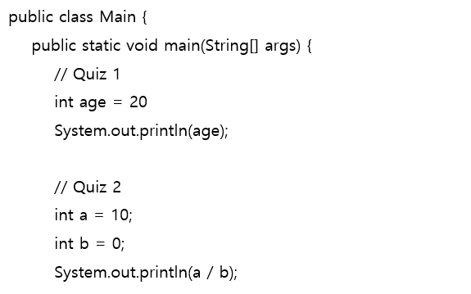
Quiz – Common mistakes for beginners
https://www.w3schools.com/java/

Slide 8
Week 2 Variables - Vocabulary
Data Type :
Declaration :
Initialisation :

Slide 9
Week 2 Variables - Vocabulary
Data Type : A classification that specifies which type of value a variable can hold, such as integers, decimals, or text.
Declaration : The process of creating a variable by giving it a name and a data type, which tells the computer to reserve space in memory.
Initialisation : The act of assigning an initial value to a variable for the first time.

Slide 10
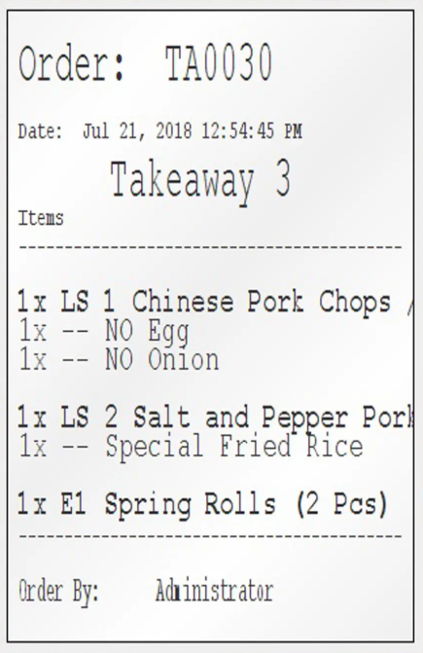
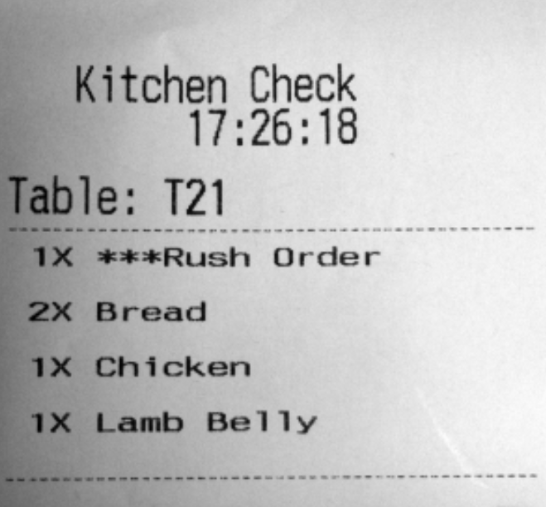
Activity 1
public class Main {
public static void main(String[] args) {
int myCoffeeCount = 1;
float myCoffeePrice = 4.5;
char currency = ‘$’;
boolean isTakeout = true;
String myCoffeeName = “long black”;
System.out.println("Order: " + myCoffeeCount + " " + myCoffeeName + " for " + currency + myCoffeePrice + " (Takeout: " + isTakeout + ")");
// Order: 1 long black for $4.5 (Takeout: true)

Slide 11
Activity 2 - Presentation
Vote for the best programmer in your group!
Selected student will share codes.

Slide 12
Reminder
Please keep your paper today!
Next session will cover week 3 -4.
Useful website https://www.w3schools.com/java/

Slide 13
Any Questions?
Ask anything!

