Slide 1
Programming Fundamentals
Week 12
Miya

Slide 2
Your U:PASS Leader - Miya
3rd years of Bachelor of Information Technology.
Majoring in Cybersecurity, Networking and Enterprise Software Development.

Slide 3
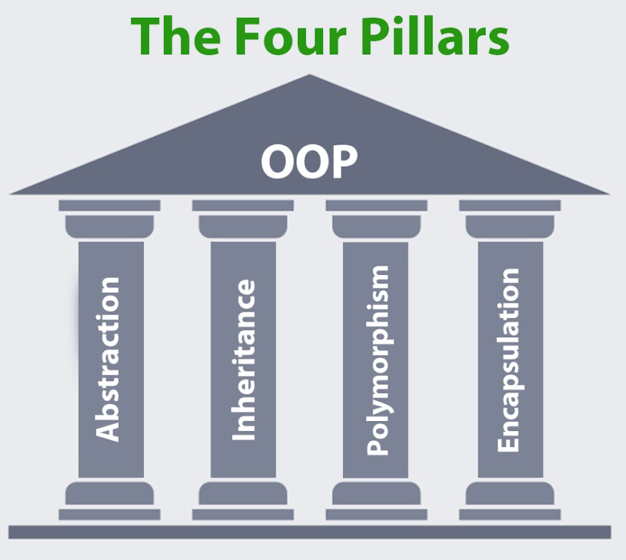

Slide 4
The Four Pillars of OOP
Abstraction
Inheritance -> We did this week 10
Polymorphism
Encapsulation -> We did this week 8

Slide 5
Abstraction
Simplify complex concept and find out common elements, essence, or function.
Why using this? -> Because it is skill to make super class/interface.
-> So that to make ‘blueprint’ of class/interface.
For example, electric car and ICE car have common function of drive and stop.

Slide 6
How to use Abstraction
1. Abstract class
2. Interface
Inheritance is mechanism(or tool) to bond between classes.
Abstraction is architect principle to see simple and find out common things between classes.
Abstraction is part of Inheritance.

Slide 7
Normal vs abstract class
Can’t we just use inherited normal class, not abstract?
-> When you don’t wanna make instance of parent class.
-> When you wanna assign some methods MUST implements.
 | Normal class inheritance | Abstract class inheritance
Level of abstraction | Low level. Just collecting common functions. | High level. Clear guideline and blueprint of class.
Can parent class make instance? | Yes. (Car class can make instance) | No. It is incomplete class.
Method implement | Child can redefine methods via overriding. | Child MUST implement abstract methods via overriding.
purpose | Extending complete functions for convenience. | Extending incomplete functions for architecting relationship and offer guide.

Slide 8
Abstract Class vs Interface
 | Abstract Class | Interface
purpose | Extend functions and share resources via inheritance. | Define specifications that class must implement. (blueprint of class)
Multiple parent | No. Only 1 extends. (no multiple inheritance) | Yes. Can do multiple implements
Field (variable) | Yes. Both variable and constant property | No. (Only available Constant using ‘Final’)
Constructor | Yes. | No. This is not inheritance.
Method | Mix of normal method and abstract method | Basically, all methods are abstract.
Instance | No. This is incomplete blueprint.
Compile error | If you don’t do all abstract methods at child.

Slide 9
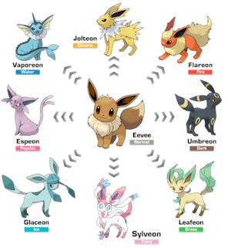
Polymorphism
It is the idea that an object (or method, property …) can have multiple types.
One thing -> different types
sister
brother
electric
me
Hyundai
ICE
Human behave brand car
drive
stop

Slide 10
Why using Polymorphism?
Simplify and avoiding repeating codes. -> One parent class can make different child classes
Maintaining collections -> All child instances can store in a one collection.
So! We can extend system (like adding new feature or child class) without modifying codes too much.
And also it is good for maintenance.
This is the ultimate concept of OOP.

Slide 11
How to use Polymorphism?
1. Inheritance
2. Abstraction (interface and abstract class)
3. Method overloading, overriding.
4. Upcasting/Downcasting

Slide 12
Reminder
I will send useful documents for finding jobs. Please share your student email.
All sessions of this semester is done!
Leave feedback at my website will be helpful.
If UTS ask feedback…

Slide 13
Any Questions?
Ask anything!

