Slide 1
Programming Fundamentals
Week 3 – 4
Miya

Slide 2
Your U:PASS Leader - Miya
3rd years of Bachelor of Information Technology.
Majoring in Cybersecurity, Networking and Enterprise Software Development.

Slide 3
Week 3 Conditionals - Vocabulary
If-Else Statement :
Comparison Operators :
Logical Operators :

Slide 4
Week 3 Conditionals - Vocabulary
If-Else Statement : A control structure that executes different blocks of code based on whether a condition is true or false.
Comparison Operators : Special symbols used to compare two values. ( ==, !=, >, < )
Logical Operators : Symbols used to connect multiple conditions (&& AND, || OR)

Slide 5

Activity 1 (15 mins)
public class Main {
public static void main(String[] args) {
Int myCoffeeCount = 3;
double myCoffeePrice = 4.5;
if ( myCoffeeCount >= 3) { // Condition: If 3 or more coffees, 20% discount
double discount = (myCoffeePrice * myCoffeeCount) * 0.2;
double totalPrice = (myCoffeePrice * myCoffeeCount) – discount;
System.out.println(“You got a 20% discount!”);
System.out.println(“Total Price: $” + totalPrice);
} else {
Double totalPrice = myCoffeePrice * myCoffeeCount;
System.out.println(“Total Price: $” + totalPrice);
}
}
}
20 % off !!

Slide 6
Week 4 Arrays - Vocabulary
Array :
Index :
Length :

Slide 7
Week 4 Arrays - Vocabulary
Array : A collection of multiple values of the same data type stored in a single variable.
Index : The specific position of an item in an array. In java, this always starts at 0.
Length : The total number of elements that an array is built.

Slide 8
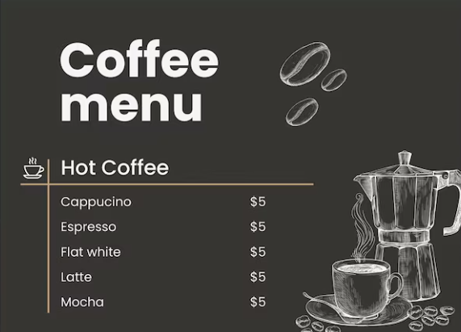
Activity 2 (15 mins)
public class Main {
public static void main(String[] args) {
String[] coffeeMenu = {“Long Black”, “Latte”, “Flat White”};
System.out.println(“--- Coffee Menu ---”);
System.out.println(“1. ” + coffeeMenu[0]); //index starts with 0!!!
System.out.println(“2. ” + coffeeMenu[1]);
System.out.println(“3. ” + coffeeMenu[2]);
System.out.println(“Total menu items: ” + coffeeMenu.length);
}
}

Slide 9
Activity 2 – Presentation (10 mins)
Vote for the best programmer in your group!

Slide 10
Reminder
Please keep your paper today!
Next session will cover week 5.
Useful website https://www.w3schools.com/java/

Slide 11
Any Questions?
Ask anything!

