Slide 1
Programming Fundamentals
Week 5
Miya

Slide 2
Your U:PASS Leader - Miya
3rd years of Bachelor of Information Technology.
Majoring in Cybersecurity, Networking and Enterprise Software Development.

Slide 3
Week 5 Loops – Vocabulary (5 mins)
Iteration:
Infinite Loop:

Slide 4
Week 5 Loops – Vocabulary (5 mins)
Iteration: A single pass through a block of code within a loop.
Infinite Loop: A logic error where the loop never ends because the condition stays

Slide 5
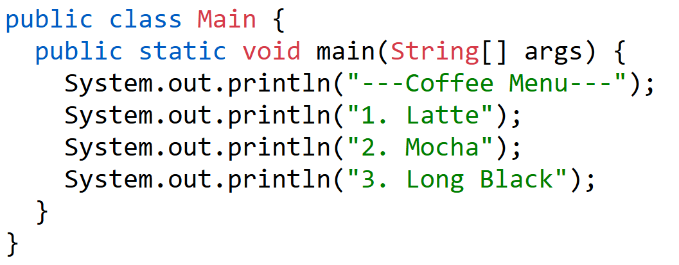
Why Loops?? (5 mins)
???

Slide 6
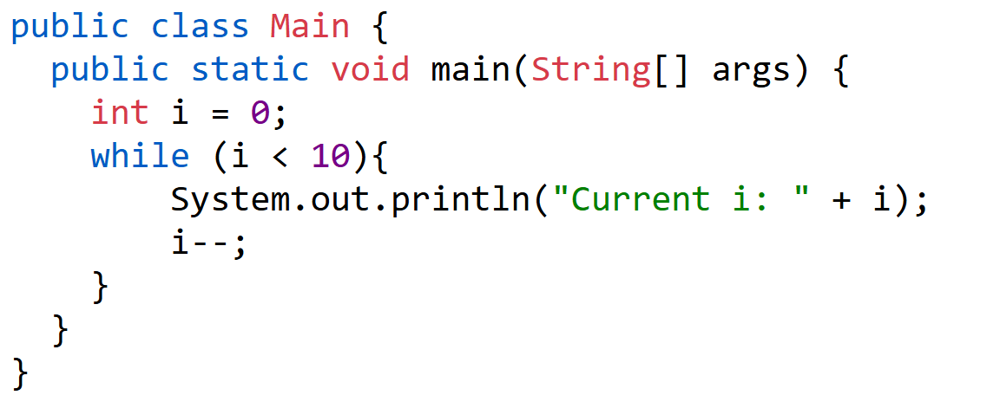
Quiz – Good or Error? And Why? (15 mins)
1.

Slide 7
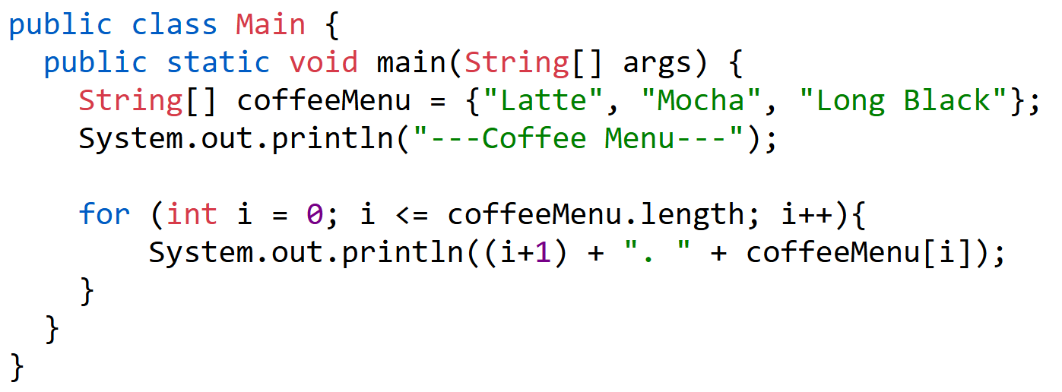
2.

Slide 8
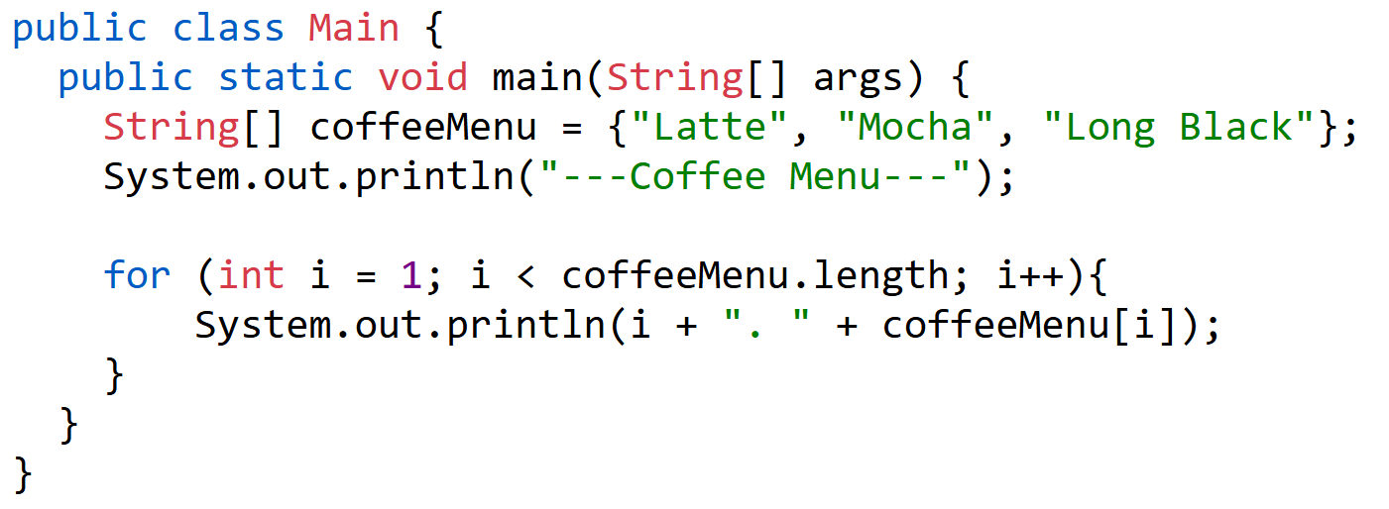
3.

Slide 9

For vs While
 | For Loop | While Loop
Main Purpose | Counted repeat | Conditional repeat
Core situation | To read all data of arrays | To wait until a specific condition is reached
Readability | Initial value, condition, and update are on one line -> making it clear | Only conditional statements are specified, it is flexible -> but can become complex
Example

Slide 10
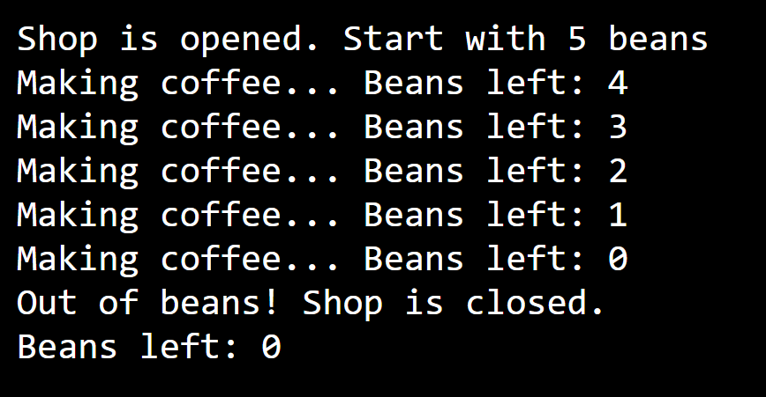
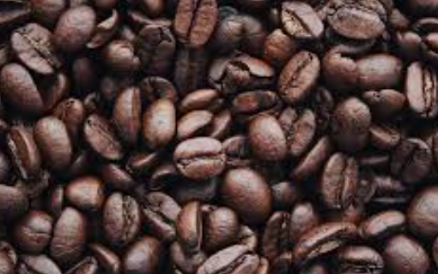
Activity – While Loop (15 mins)
Let’s make an example with While Loop!!

Slide 11
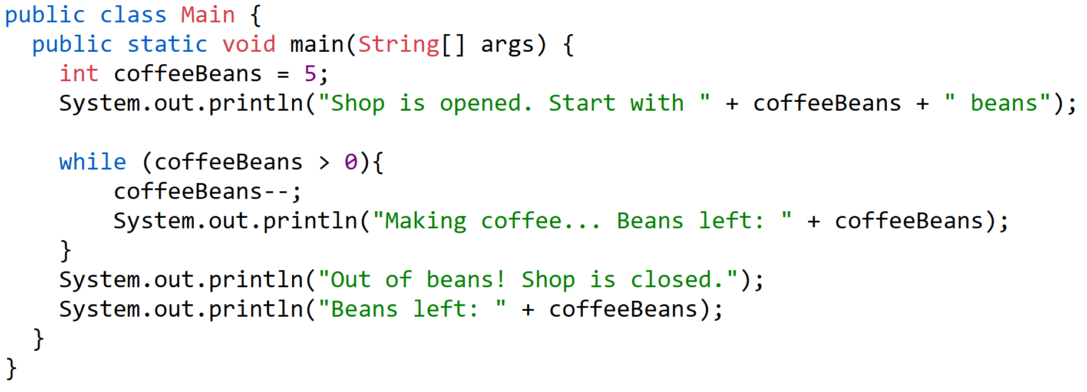
Miya’s Example

Slide 12
Reminder
Please keep your paper today!
Next session will cover week 6 – Methods!
Useful website https://www.w3schools.com/java/

Slide 13
Any Questions?
Ask anything!

