Slide 1
Programming Fundamentals
Week 6
Miya

Slide 2
Your U:PASS Leader - Miya
3rd years of Bachelor of Information Technology.
Majoring in Cybersecurity, Networking and Enterprise Software Development.

Slide 3
Why using Methods?
Shallow Answer : Because it is Java’s grammar rule.
1. No Floating Code!!
2. To run Java program, should have main method.
Deep Answer : For better Structure, managing effective
1. Modularity – Easy to maintain, understand
2. Code Reuse – No need to type same code repeatedly.
3. Maintenance – No need to check all codes, just fix problematic method
4. Readability – calculateTotal(), printMenu() We can guess these jobs

Slide 4
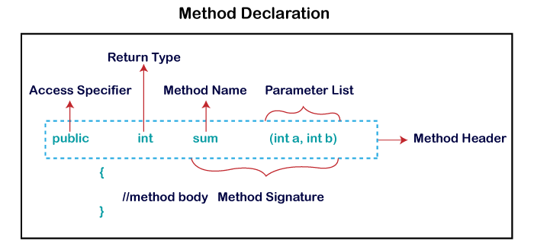

Slide 5
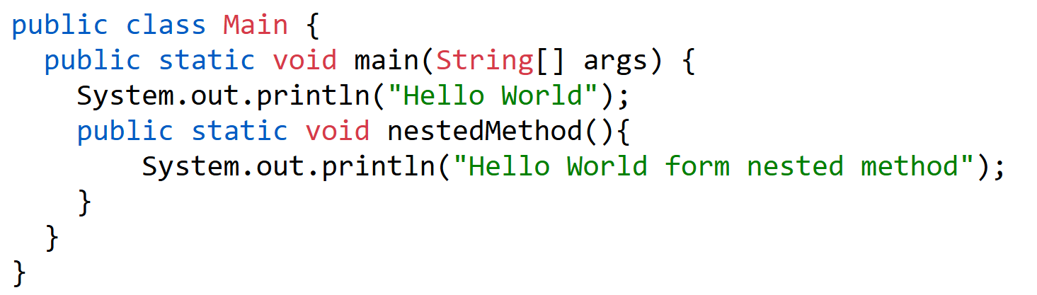
Quiz – Compile or Error (common mistakes for beginners)
1.

Slide 6
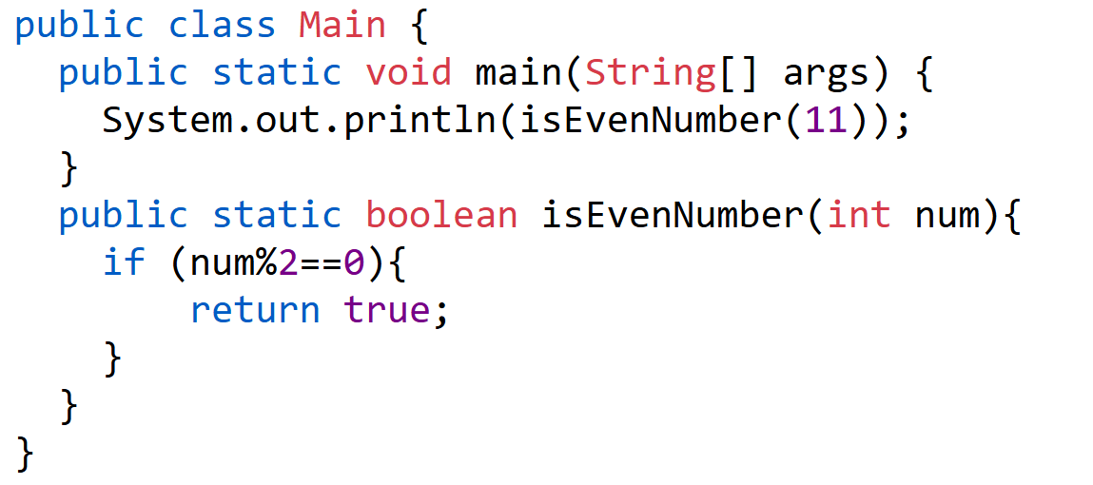
2.

Slide 7
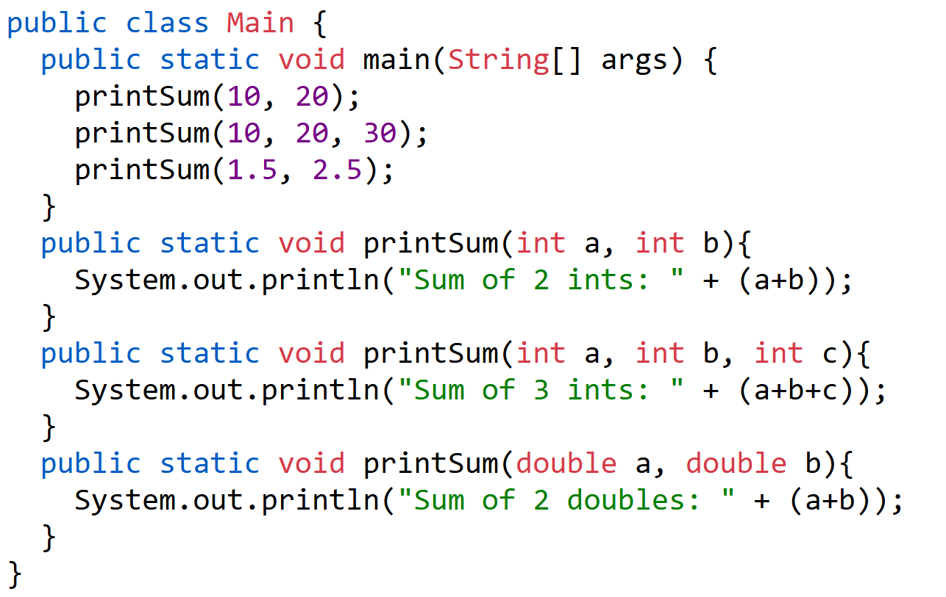
3.

Slide 8
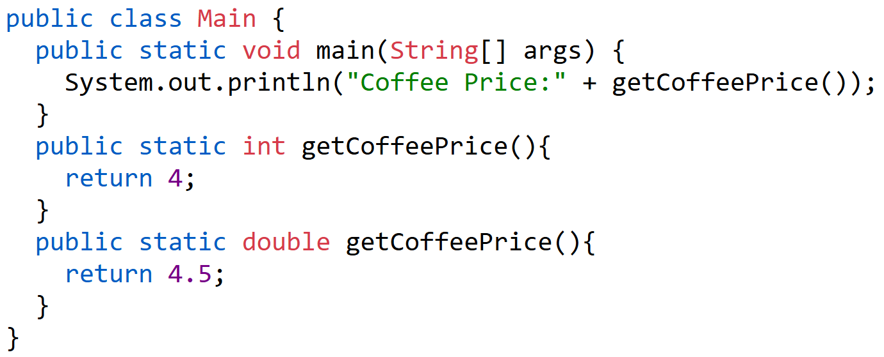
4.

Slide 9
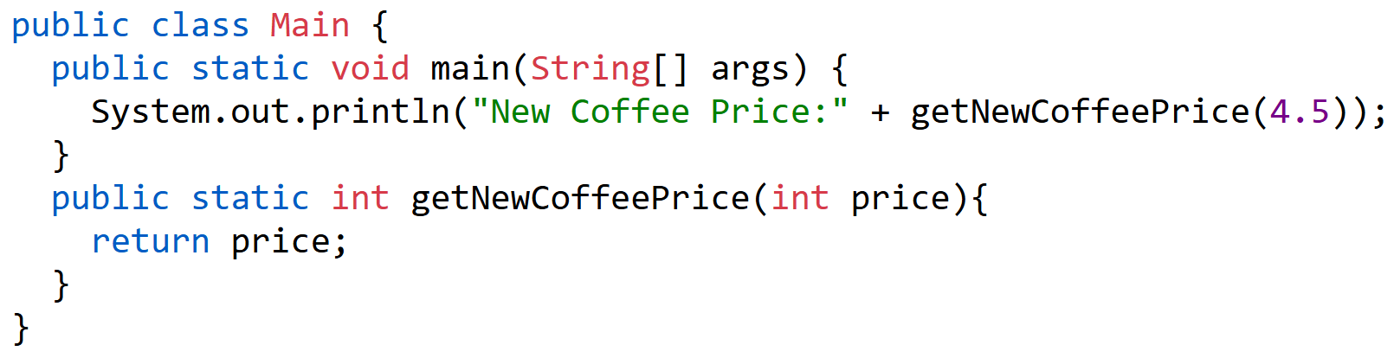
5.

Slide 10
Reminder
Please keep your paper today!
Next session will cover week 6.
Useful website https://www.w3schools.com/java/

Slide 11
Any Questions?
Ask anything!

