Slide 1
Programming Fundamentals
Week 8
Miya

Slide 2
Your U:PASS Leader - Miya
3rd years of Bachelor of Information Technology.
Majoring in Cybersecurity, Networking and Enterprise Software Development.

Slide 3
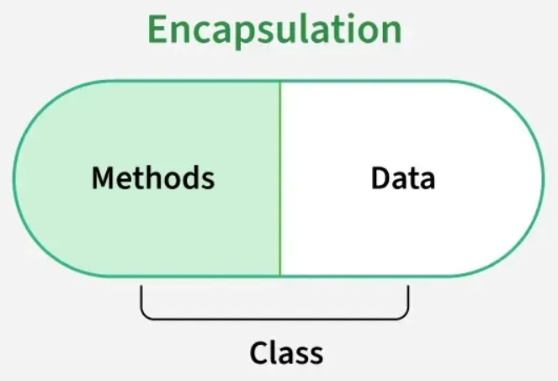
What is Encapsulation?
Combining data and the functions that work on that data into a single unit, like class, library ...
Hiding internal field and only allow to access through methods.

Slide 4
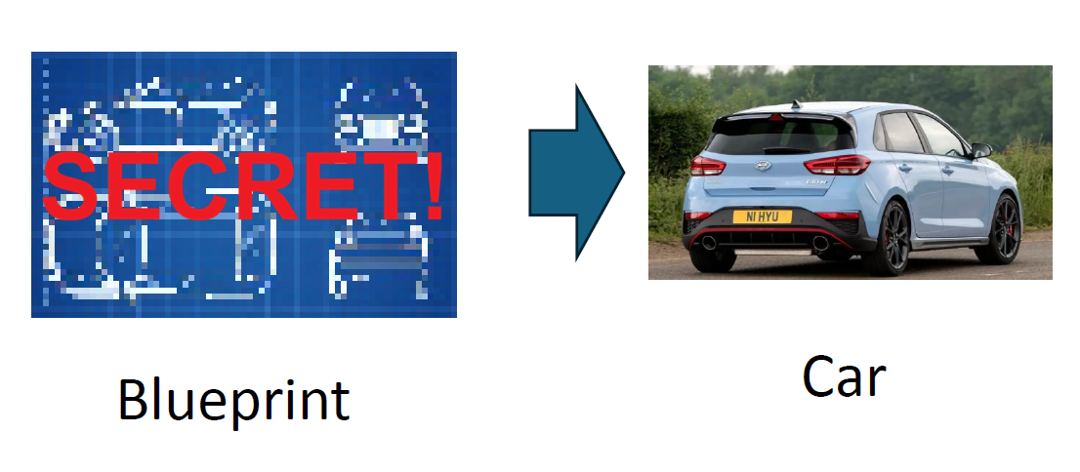
Why Encapsulation?
Advanced Driver Assistance System
Engine Technology
AI-based Perception / Control
Robotics
Users can access these info only
Manufacturer
model
colour
fuelLevel
…
drive()
refillFuel()
…
Model Name : i30N
Fuel Level : 100
Manufacturer : Hyundai

Slide 5
Why Encapsulation?
Easy to use, only access via methods so that don’t need to understand codes.
Block bad guys to change data and algorithm. -> DATA INTEGRITY
Keep secret of credential information.

Slide 6
How to Encapsulate?
1. Access Modifier (public / private)
2. Getter / Setter
3. Read-Only (final)

Slide 7

Let’s play with Java codes! Activities!
Given Car.java file is not fully encapsulated. See what happen!
1. Access into properties and manipulate them.
2. Access into methods and manipulate them.
3. Access into secret data.
4. Hyundai find out there is malicious user! Patch!
5. “I want to change colour in a legal way.”
Access Modifier (public / private)
Getter / Setter

Slide 8
Reminder
Please keep your paper today!
Next session will cover week 9.
Useful website https://www.w3schools.com/java/

Slide 9
Any Questions?
Ask anything!

