Slide 1
Programming Fundamentals
Week 9
Miya

Slide 2
Your U:PASS Leader - Miya
3rd years of Bachelor of Information Technology.
Majoring in Cybersecurity, Networking and Enterprise Software Development.

Slide 3
What is Collection?
A special type of variable designed to manage sequences of values more flexibly than a standard array.

Slide 4

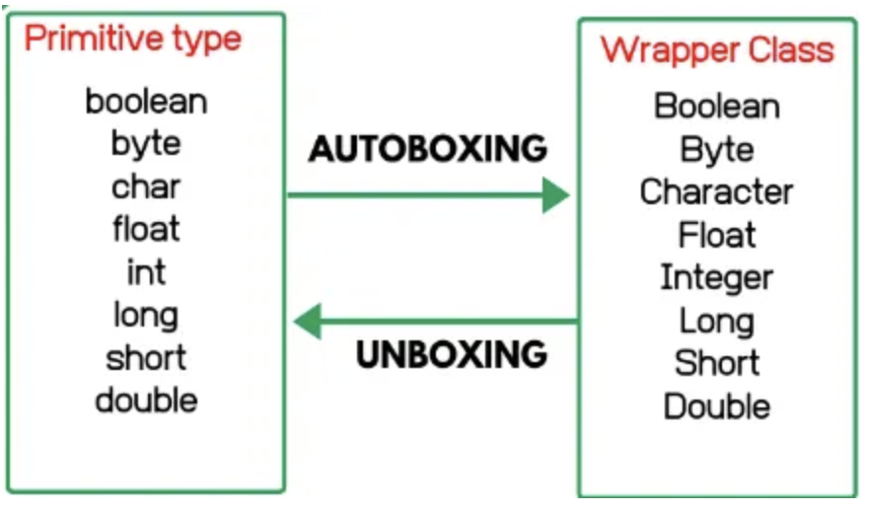
What is Wrapper Class?
Autoboxing | Unboxing
primitive value -> wrapper object | wrapper object -> primitive value
int x = 10; Integer y = x; // Autoboxing: int -> Integer | Integer x = 10; int y = x; // Unboxing: Integer -> int
10
10
Integer x
int x = 10;
Integer x = new Integer(10);
Type Value
Class Instance / Object
Car myCar = new Car(“i30N”);

Slide 5
Why Use Wrapper Classes?
Object-oriented programming: Many Java features require objects. Wrapper classes enable using primitive values in object-oriented environments.
To use collections (ArrayList, LinkedList ...). Because they don’t accept primitive value.
To use useful methods. Because only objects can use methods.
To contain “NULL”.

Slide 6
Why Collection?
 | Array | Collection
Size | Fixed | Dynamic
Type Restriction and Examples | Primitive types (int, double …) int[] scores = {90, 85, 77}; Objects (Car, String …) String[] fruits = {"Apple", "Banana"}; Car[] garage = new Car[2]; garage[0] = new Car("BMW"); garage[1] = new Car("Hyundai"); Wrapper Class (Integer, Double …) Integer[] numbers = {new Integer(10), new Integer(20)}; | No Primitive types! ArrayList<int> list = new ArrayList<int>(); //compile error!! Objects (Car, String …) ArrayList<String> fruits = new ArrayList<String>(); fruits.add(”Apple"); fruits.add(“Banana”); //unlimited fruit space!! ArrayList<Car> garage = new ArrayList<Car>(); garage.add(“BMW”); garage.add(“Hyundai”); //unlimited garage space!! garage.add(null); // empty garage space!! Wrapper Class (Integer, Double …) ArrayList<Integer> numbers = new ArrayList<Integer>(); numbers.add(10); numbers.add(20);
Methods | Limited. Accessing directly with index. | Support useful methods. add(), remove(), get(), set() ...
Memory effectiveness | Immediately occupies memory equal to the declared size. | It adjusts according to the amount of data, but expanding the internal array may incur additional resources.
Data Search Speed | Very fast via index | ArrayList is fast, but LinkedList becomes slower as the number of elements increases.

Slide 7
[10, 20, null]
Empty...?
It’s not ’0’.
Integer
numbers
int[] numbers = {10, 20, ? };
 | Array | Collection
insert new element | Nope! Fixed size! | Add at the back : numbers.add(30); // [10,20,null,30] Insert at the index num ; numbers.add(1, 15); // [10, 15, 20, null]
remove | Nope! Fixed size! | Remove at the index num : numbers.remove(0); // [ 20, null]
read value | Use index int value = number[1]; | Integer value = numbers.get(1); //value is 20
change value | Use index number[0] = 15; | numbers.set(0, 15); // [15,20,null]

Slide 8


ArrayList vs LinkedList
20
Array
node
[10, 20, null]
10
null
node
node
Integer
numbers
Integer
numbers
 | ArrayList | LinkedList
get() | Very Fast. Because use index and jump. | Slow. Because must navigate index from 0..
add(), remove() | Slow. It often requires shuffling elements to fill or make gaps. | Very Fast. Only requires changing the pointers.
Memory Usage | Can use more memory than necessary if the internal array is larger than needed. | Requires additional memory to store the pointers (references) for each node.
Capacity | Has a fixed internal capacity; when full, it must copy all data to a new, larger array. | Does not have a fixed capacity; it can grow as long as there is memory available.

Slide 9
Activity!
Let’s make ‘unlimited garage’!
1. make garage.
2-1. park myCar into your garage.
2-2. park sisCar at the first of parking lot.
2-3. park broCar at the last of parking lot.
2-4. park dadCar at the lot 2. (index 2)
2-5. empty parking lot number 3. (index 3)
3. remove broCar.
4. check whose car is parked at lot 1. (index 1)
5. change myCar into newCar.
6. Check now many cars park at this garage? Use size()
7. Is this garage empty or park at least one? Use isEmpty()
8. Check momCar is parked at this garage. Use contains(Object o)
9. Check where is dadCar? Use indexOf(Object o)
10. Destroy all cars!!! Use clear()

Slide 10
Reminder
Please keep your paper today!
Next session will cover week 10.
Useful website https://www.w3schools.com/java/

Slide 11
Any Questions?
Ask anything!

